Slide 1
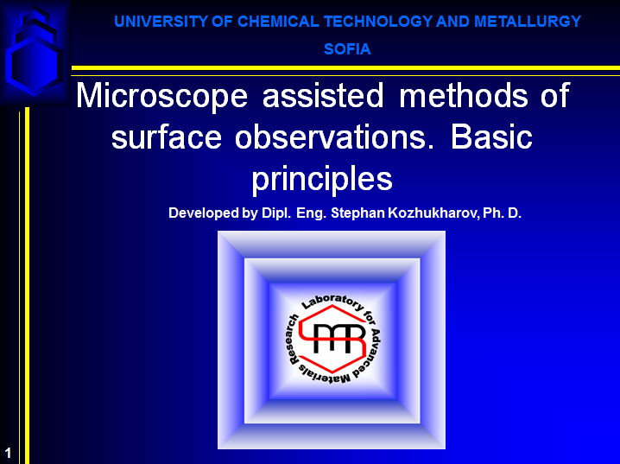

Slide 2
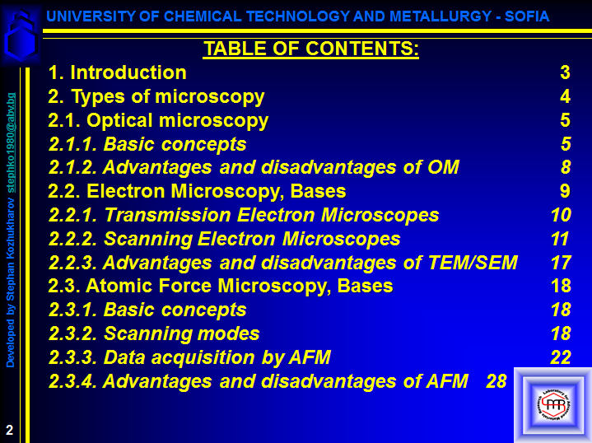

Slide 3
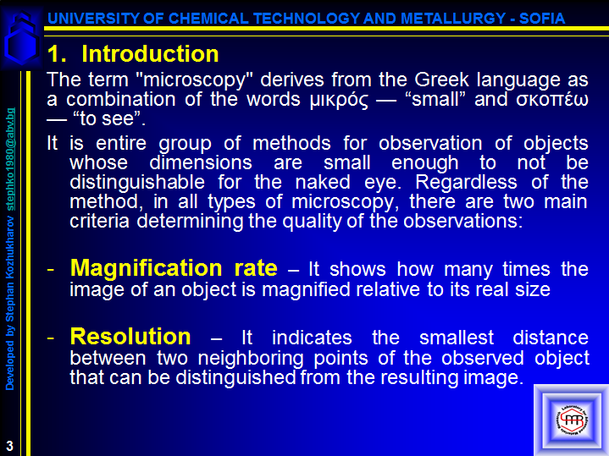

Slide 4
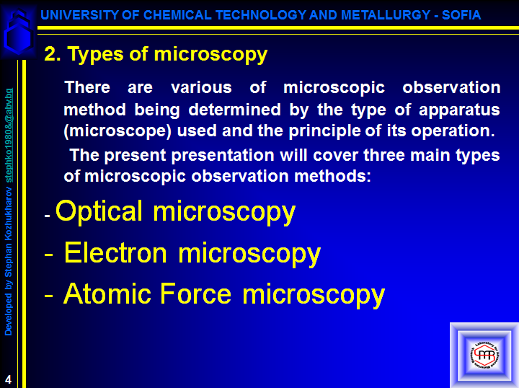

Slide 5
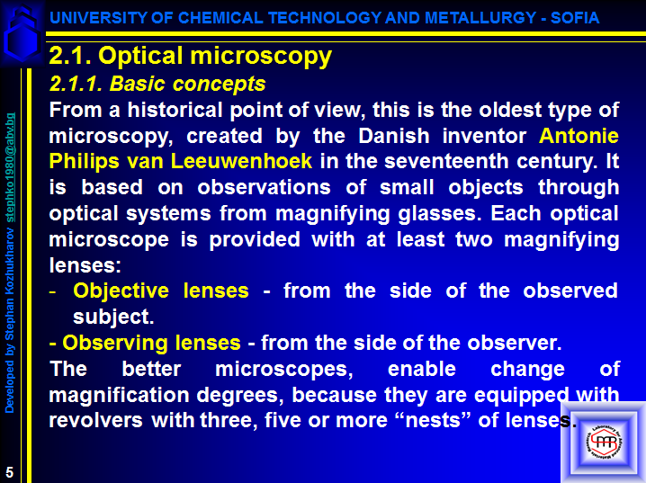

Slide 6
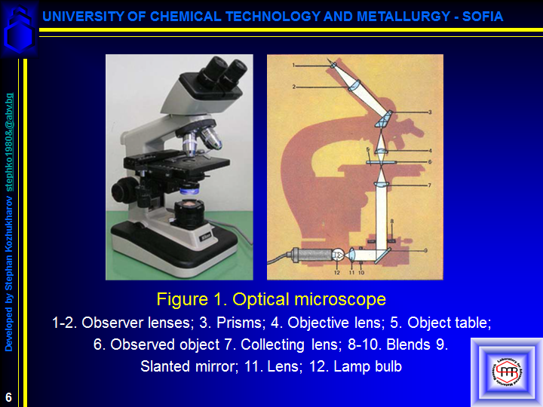

Slide 7
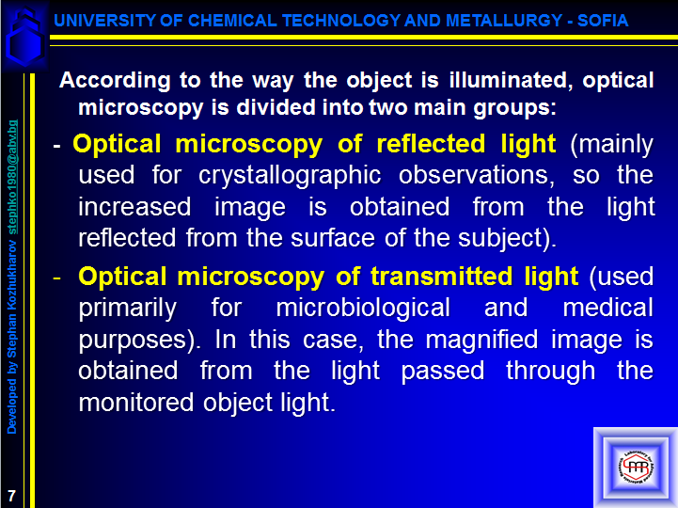

Slide 8
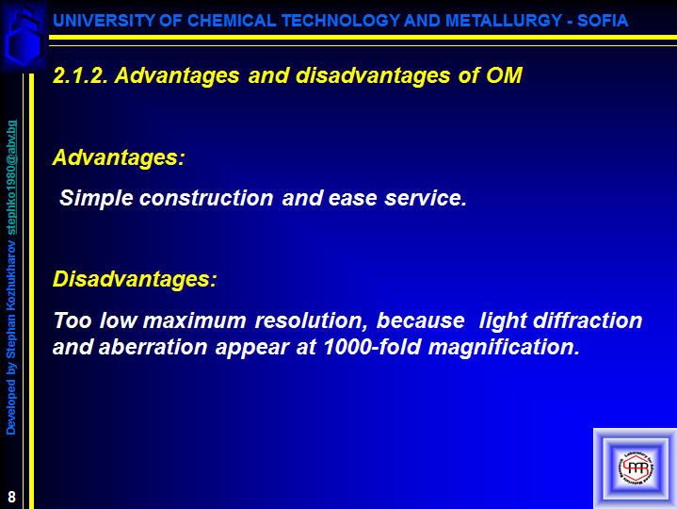

Slide 9
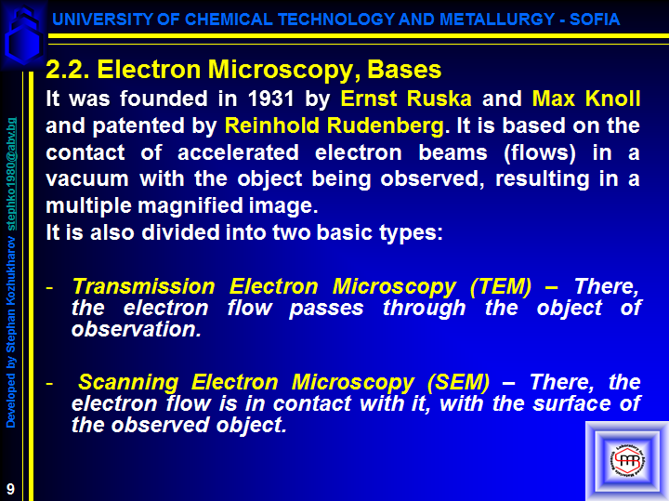

Slide 10
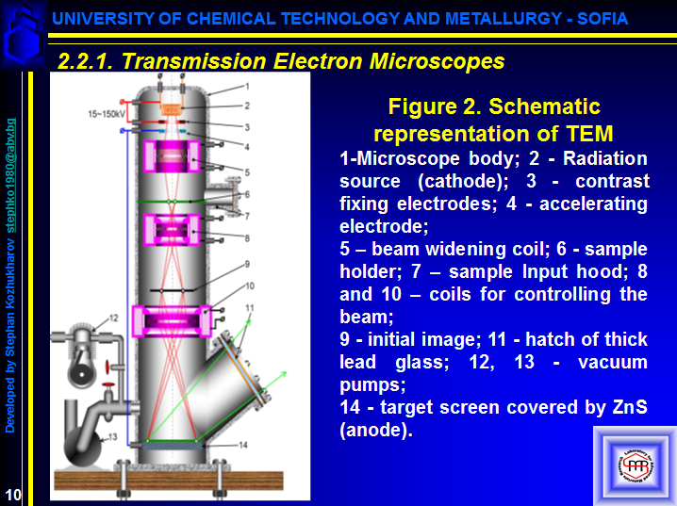

Slide 11
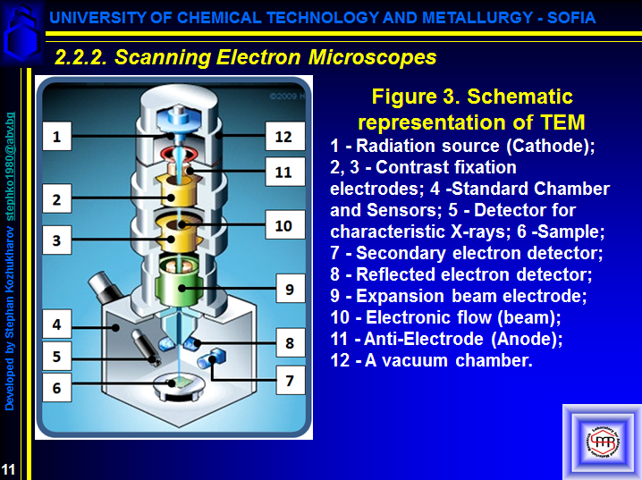
Adopted from:
http://science.howstuffworks.com/scanning-electron-microscope2.htmL

Slide 12
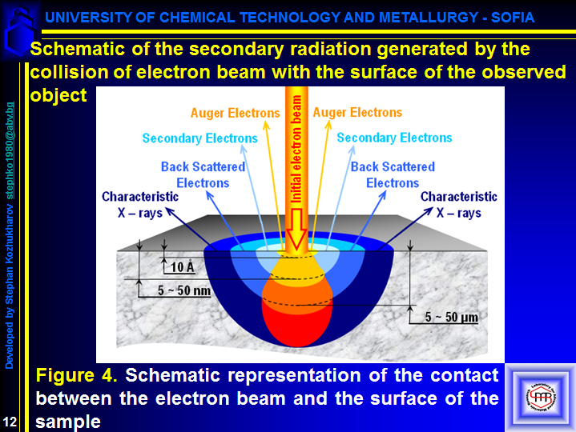

Slide 13
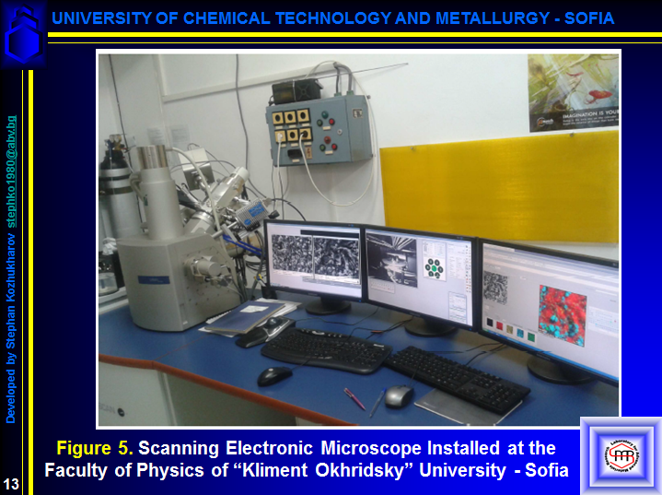

Slide 14
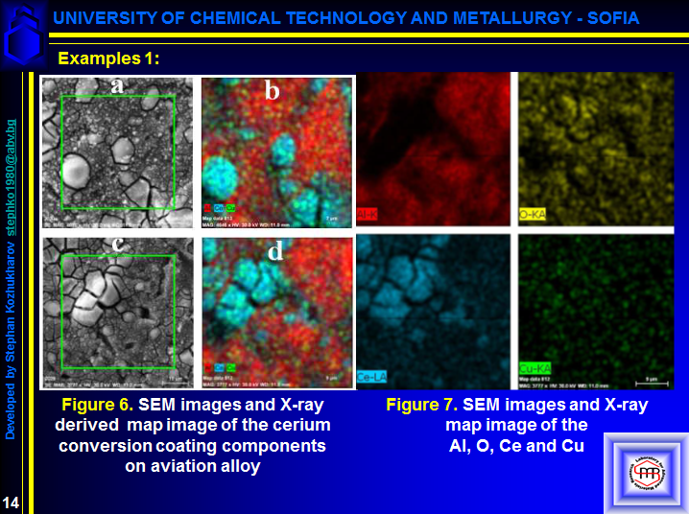

Slide 15
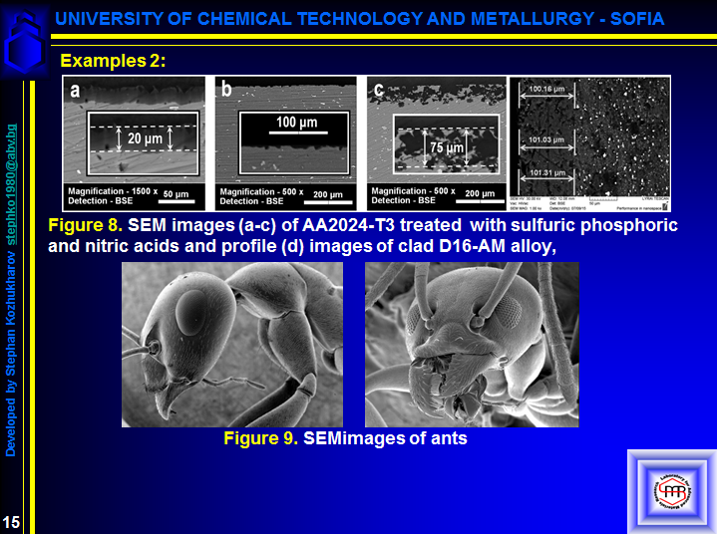
https://www.google.com/search?hl=en-BG&authuser=0&biw=1242&bih=568&tbm=isch&sa=1&ei=Nu6yXKmZA-WU1fAP1J2bmAc&q=scanning+electron+microscopy+ant&oq=scanning+electron+microscopy+ant&gs_l=img.3...43567.44524..45724...0.0..0.244.677.0j3j1......1....1..gws-wiz-img.......0j0i24.Lrul3k9E1aU#imgrc=RK6ZQ2lROOuNVM
https://www.google.com/search?biw=1242&bih=568&tbm=isch&sa=1&ei=6yzYXNCvIPCGjLsP7qq1wAE&q=scanning+electron+microscopy++image+buttergfly&oq=scanning+electron+microscopy++image+buttergfly&gs_l=img.3...95976.99331..100652...2.0..0.159.1060.5j5......1....1..gws-wiz-img.HLK8LdRiAS4#imgdii=YrPEP7E32-zNVM:&imgrc=GlBkrK6RMurjhM:

Slide 16
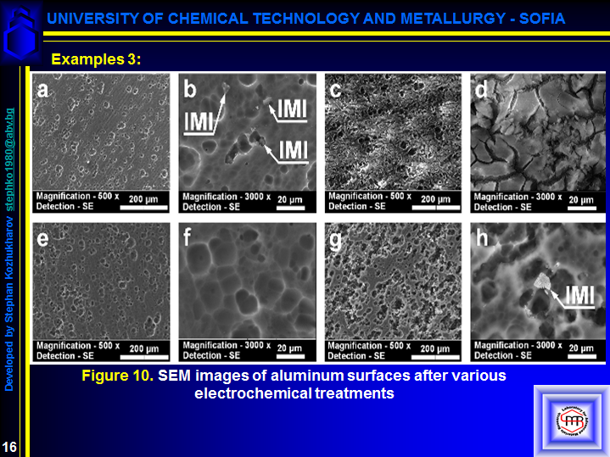
S. Kozhukharov, Ch. Girginov, I. Avramova, М. Machkova, Anodic galvanostatic polarization of AA2024-T3 aircraft alloy in conventional mineral acids, Materials Chemistry and Physics, 180 (2016) 301 – 313 IMPACT FACTOR: 2.101
https://www.researchgate.net/publication/304145273_Anodic_galvanostatic_polarization_of_AA2024-T3_aircraft_alloy_in_conventional_mineral_acids

Slide 17
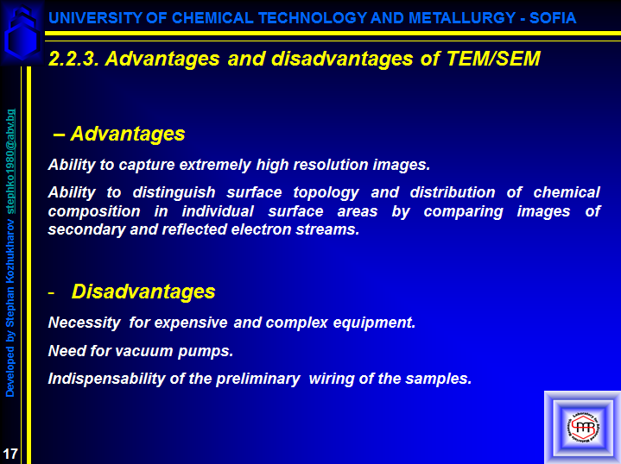

Slide 18
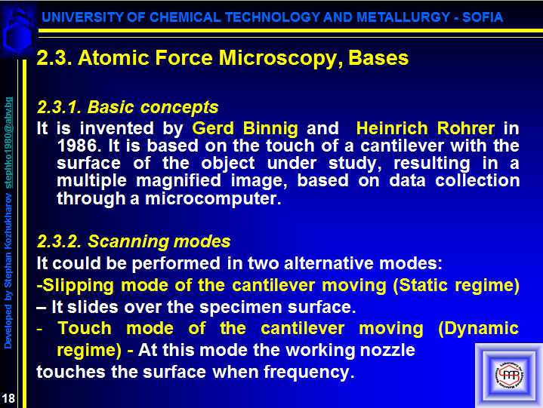

Slide 19
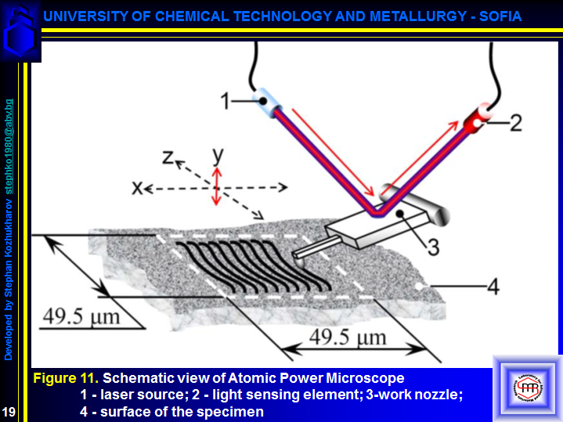

Slide 20
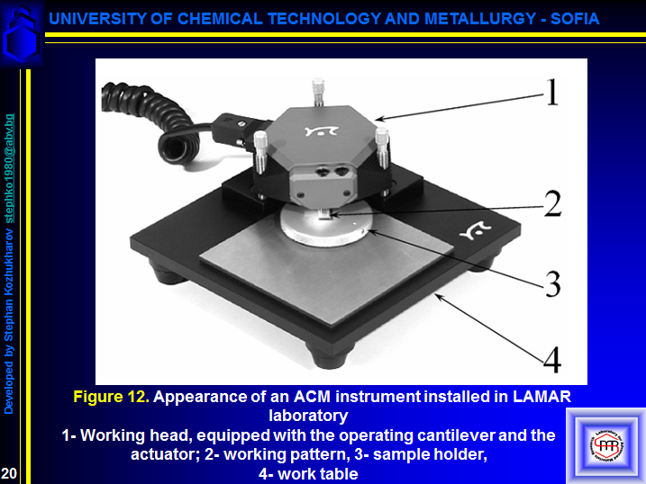

Slide 21
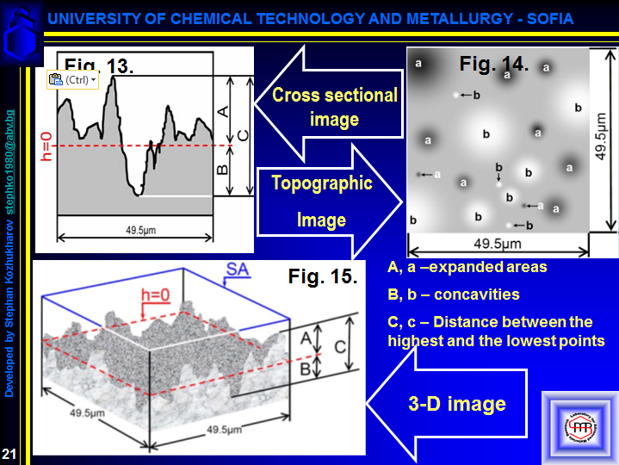
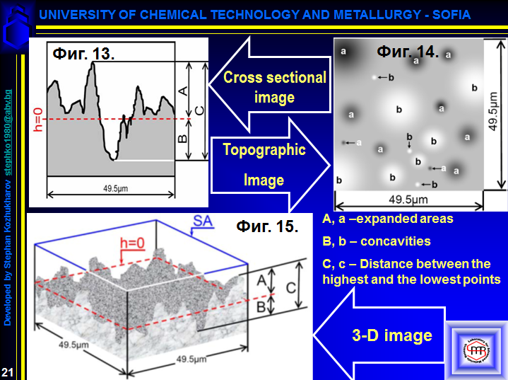

Slide 22
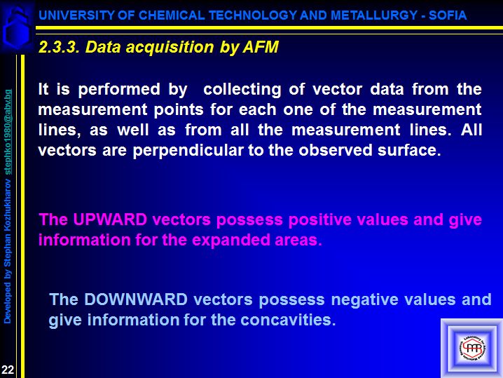

Slide 23
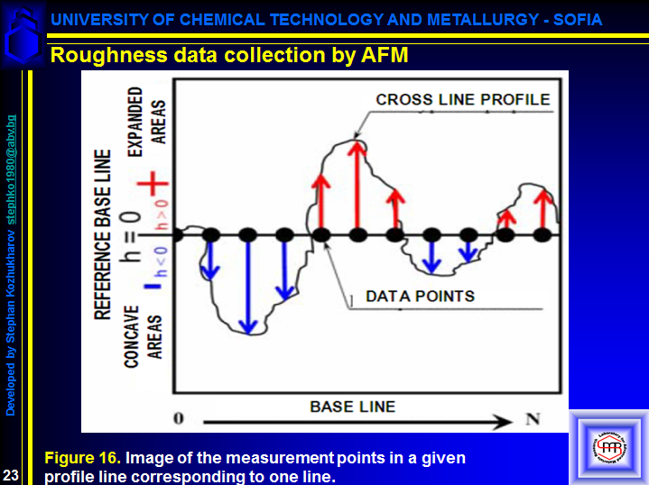

Slide 24
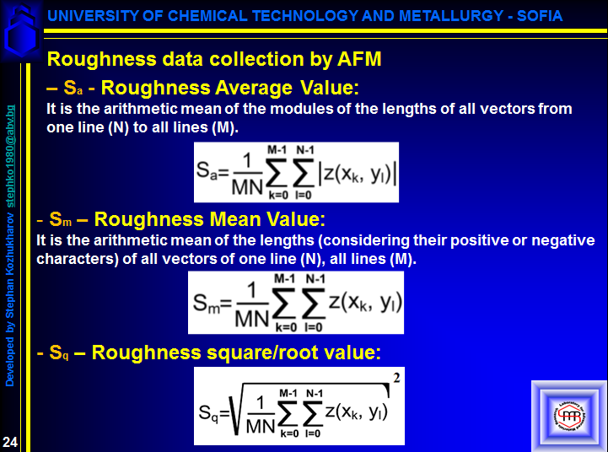

Slide 25
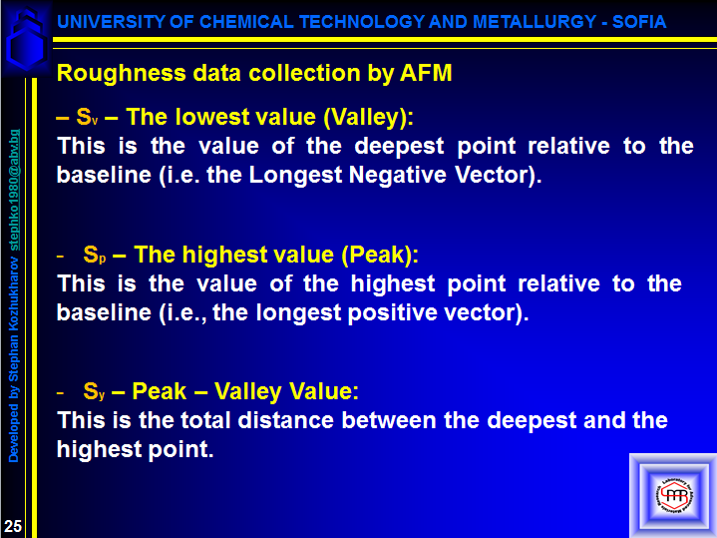

Slide 26
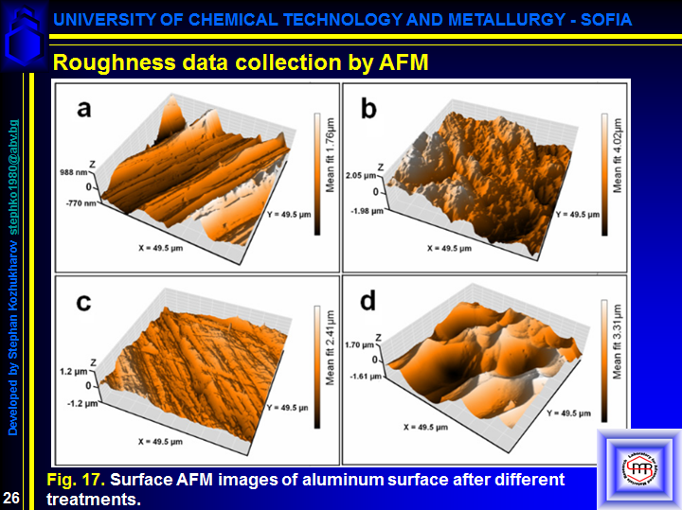

Slide 27
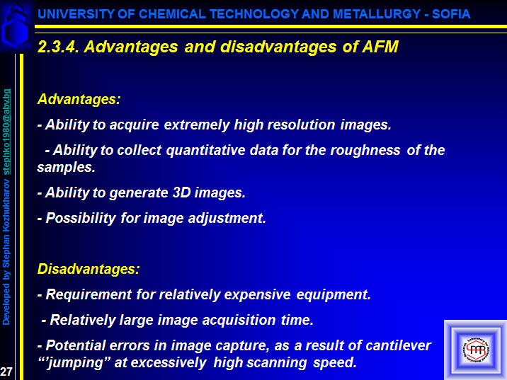

Slide 28
